Slide 1
Chapter 9: Virtual Memory
May, 2024

Slide 2
Chapter 9: Virtual Memory
Background
Demand Paging
Swapping

Slide 3
Objectives
To explain the concepts of demand paging
To explain the concepts of swapping

Slide 4
Review
Physical memory layout

Slide 5
Three Issues
Space
Time
Protection
Address Translation

Slide 6
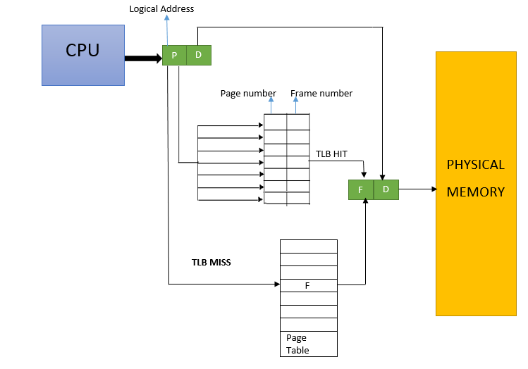
Address Translation with Paging
TLB

Slide 7
Thinking About
./a.out
How much memory to be allocated?
How much memory at most?
Which part of free memory space is allocated?
If a.out is run twice, will the memory space allocated to it be the same? If not, will the execution of a.out be affected?
How to prevent other processes from accessing the memory space of a.out?
Notes:
To answer these two questions,
Demand paging
Swapping

Slide 8
Thinking About
./a.out
How much memory to be allocated?
How much memory at most?
Which part of free memory space is allocated?
If a.out is run twice, will the memory space allocated to it be the same? If not, will the execution of a.out be affected?
How to prevent other processes from accessing the memory space of a.out?
Notes:
To answer these two questions,
Demand paging
Swapping

Slide 9
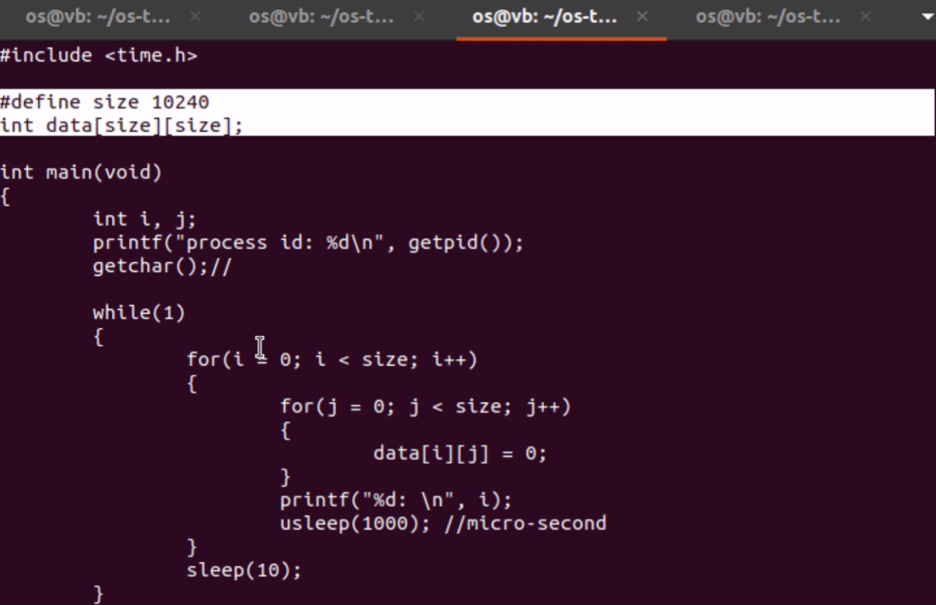
Programs could be partially in memory!
demo
Notes:
This illustrates (pure) demand paging
Give an example: int data[1024][1024]
top -p pid
d: 0.1s
res: 物理内存(KiB)

Slide 10
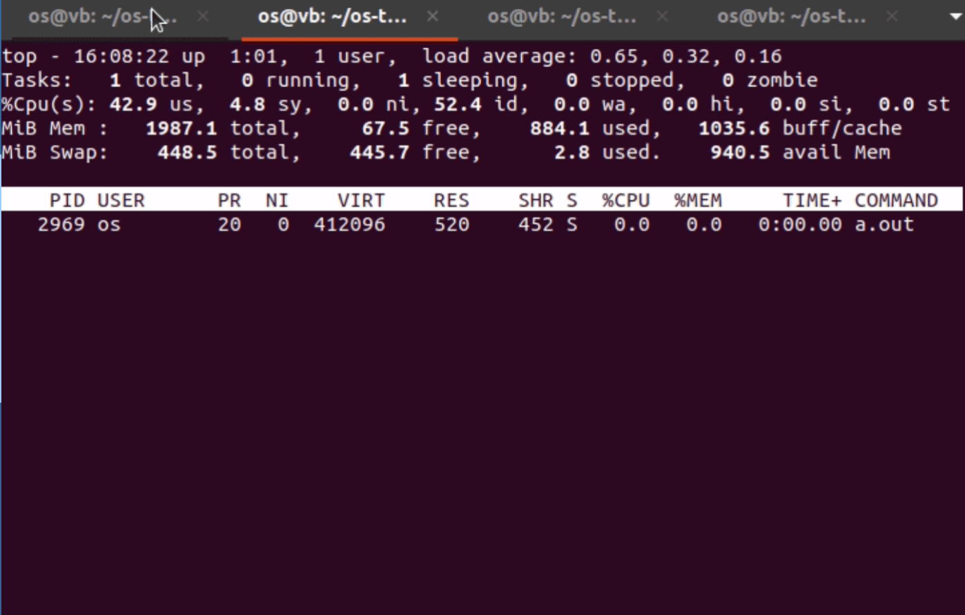
Programs could be partially in memory!
demo
Notes:
This illustrates (pure) demand paging
可以看到我们虚拟内存占有了很多，这是因为在加载程序时开辟了我们的全局数组到data区。
但是RES（物理地址）只用了一点，说明在加载程序时没有建立完整的映射关系，还没有为这个庞大的数组分配frame

Slide 11
Programs could be partially in memory!
demo
Notes:
RES（物理内存）是随着程序运行不断请求调页，因为不断地需要调用数组中的某一块内存

Slide 12
Background
In many cases, the entire program is not needed
Programs often have code to handle unusual error conditions. Since these errors seldom, if ever, occur in practice, this code is almost never executed.
Arrays, lists, and tables are often allocated more memory than they actually need.
Certain options and features of a program may be used rarely.

Slide 13
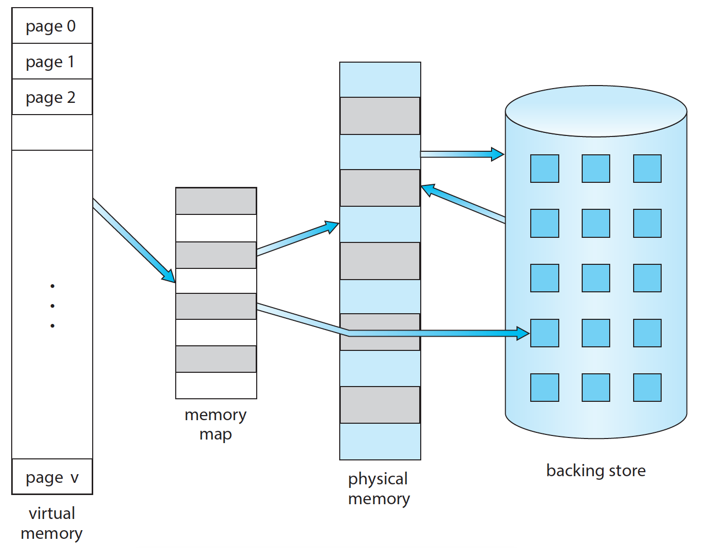
Backing Store
page
table
Notes:
Backing store 或者叫做 secondary storage

Slide 14
Page demanding
Programs could be partially in memory!
Others in backing store!
Only the pages needed are loaded into memory (on demand)!

Slide 15
Demand Paging
Bring a page into memory only when it is needed
Page is needed ⇒ reference to it
not-in-memory ⇒ bring to memory
Advantages
Less I/O needed, no unnecessary I/O
Less memory needed
More users

Slide 16
Extreme Case: Pure demand paging
Start process with no pages in memory
OS sets instruction pointer to first instruction of process
non-memory-resident（无内存驻留） -> bring into memory
And for every other process pages on first access

Slide 17
How to implement
If pages needed are already memory resident
No difference from non demand-paging
If page needed and not memory resident
Need to detect and load the page into memory from storage
Without changing program behavior
Without programmer needing to change code

Slide 18
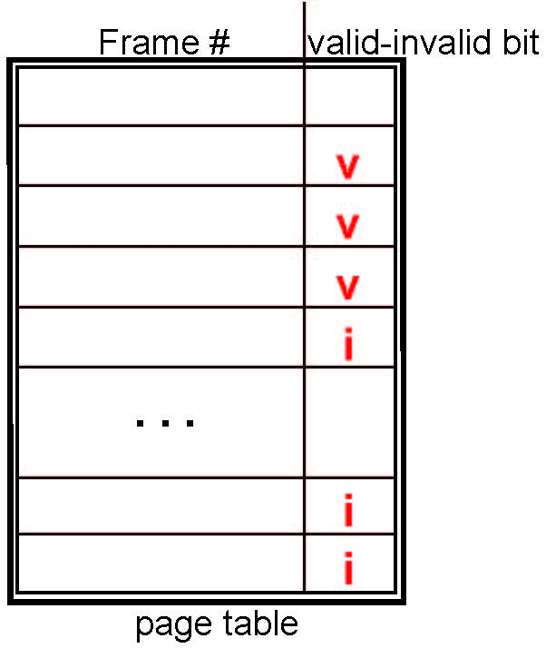
Page table support
With each page table entry a valid–invalid bit is associated (v ⇒ in-memory – memory resident, i ⇒ not-in-memory)
Initially valid-invalid bit is set to i on all entries
Example of a page table snapshot:

Slide 19
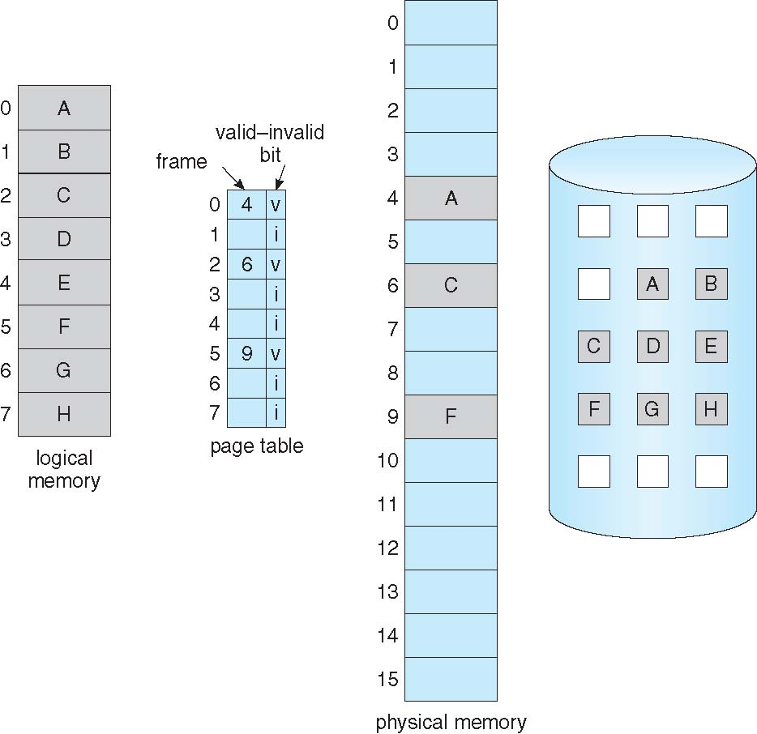
Valid-invalid Bit

Slide 20
Page Fault
During MMU address translation, if valid–invalid bit in page table entry is i ⇒ page fault
Hardware support
demo
OS support
Notes:
Divided by zero fault会导致Exception（由CPU引起），而不是interrupt（由外部设备引起）

Slide 21
Interrupt and Exceptions
exception
fetch | decode | execute | fetch | decode | execute | fetch | decode | execute
interrupt

Slide 22
OS support: handling page fault
page fault
Trap into OS kernel
Handling of page fault
Operating system decides:
Invalid reference ⇒ abort
Just not in memory
Find free frame
Read page into frame via scheduled disk operation
Reset page table to indicate page now in memory Set validation bit = v
Restart the instruction that caused the page fault

Slide 23
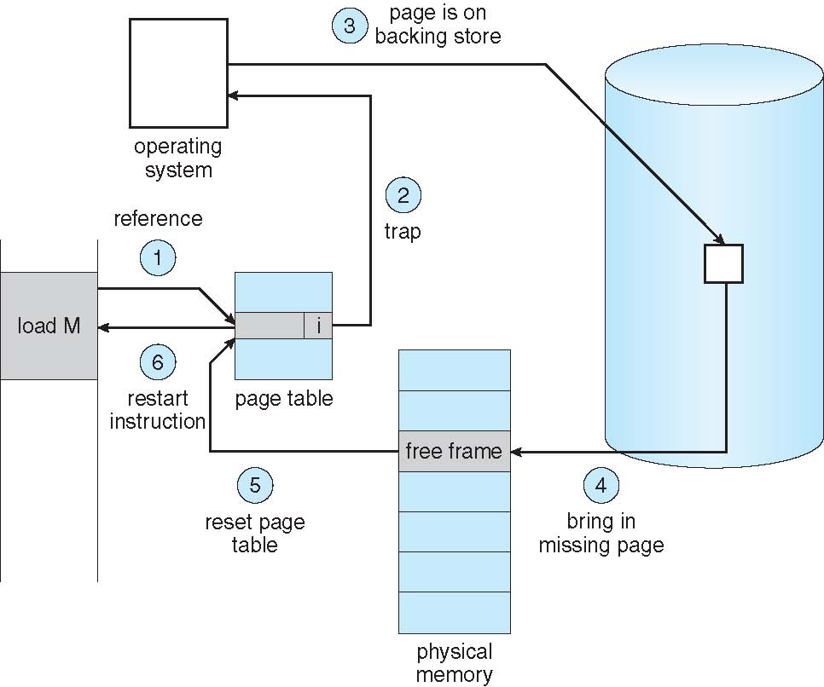
Steps in Handling a Page Fault
V

Slide 24
Performance of Demand Paging
Trap to the operating system
Save the user registers and process state
Determine that the interrupt was a page fault
Check that the page reference was legal and determine the location of the page on the disk
Issue a read from the disk to a free frame:
Wait in a queue for this device until the read request is serviced
Wait for the device seek and/or latency time
Begin the transfer of the page to a free frame
Notes:
陷入操作系统。
保存用户寄存器和进程状态。
确定中断是否为缺页错误。
检查页面引用是否合法，确定页面的磁盘位置。
从磁盘读入page到空闲frame：
a) 在磁盘队列中等待，直到请求被处理。
b) 等待磁盘寻道和延迟
c) 开始传输磁盘page到空闲frame

Slide 25
Performance of Demand Paging
While waiting, allocate the CPU to some other user
Receive an interrupt from the disk I/O subsystem (I/O completed)
Save the registers and process state for the other user
Determine that the interrupt was from the disk
Correct the page table and other tables to show page is now in memory
Wait for the CPU to be allocated to this process again
Restore the user registers, process state, and new page table, and then resume the interrupted instruction
Notes:
6. 刚才在磁盘队列等待时可以将CPU分配给其它进程。
7. 收到来自IO的中断（请求完成）
8. 保存CPU正在处理的其它进程的寄存器和进程状态
9. 确认中断来自刚才的磁盘
10. 修改page table 和 TLB
11. 等待CPU分配给本进程
12. 恢复寄存器，进程状态，重新执行被中断的指令

Slide 26
Performance of Demand Paging
Three major activities
Service the interrupt – careful coding means just several hundred instructions needed
Read the page – lots of time
Restart the process – again just a small amount of time
Notes:
访问磁盘是最耗时的

Slide 27
Performance of Demand Paging (Cont.)
Page Fault Rate 0 ≤ p ≤ 1
if p = 0 no page faults
if p = 1, every reference is a fault
Effective Access Time (EAT)
EAT = (1 – p) x memory access
+ p x page fault time

Slide 28
Performance of Various Levels of Storage

Slide 29
EAT Computation Example
Memory access time = 200 nanoseconds (ns)
Average page-fault service time = 8 milliseconds (ms)
EAT = (1 – p) x 200 + p x (8 milliseconds)
= (1 – p) x 200 + p x 8,000,000 (ns)
= 200 + p x 7,999,800 (ns)
If one access out of 1,000 causes a page fault, then
EAT = 8.2 microseconds (us)
41*200ns
If want performance degradation < 10 percent
220 > 200 + 7,999,800 x p 20 > 7,999,800 x p
p < 0.0000025
< one page fault in every 400,000 memory accesses
Notes:
这里的内存访问就是指一次内存访问

Slide 30
Thinking About
Virtual space
Physical memory
Disk
./a.out
How much memory to be allocated?
How much memory at most?
Which part of free memory space is allocated?
If a.out is run twice, will the memory space allocated to it be the same? If not, will the execution of a.out be affected?
How to prevent other processes from accessing the memory space of a.out?
Notes:
To answer these two questions,
Demand paging
Swapping

Slide 31
Swapping

Slide 32
Not enough frames?
Physical memory layout
Notes:
Yellow is free

Slide 33
Not enough frames?
Physical memory layout
Notes:
That’s where swapping comes in: yellow is free

Slide 34
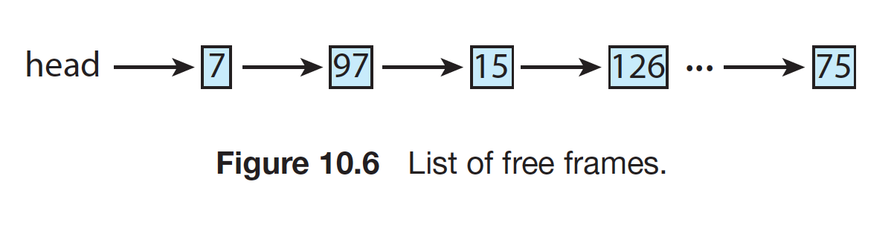
Free Frame List
OS maintain a free-frame list: a pool of free frames
When a system starts up, all available memory is placed on the free-frame list
As free frames are requested, the size of the free-frame list shrinks

Slide 35
Steps in Handling a Page Fault
No free!

Slide 36
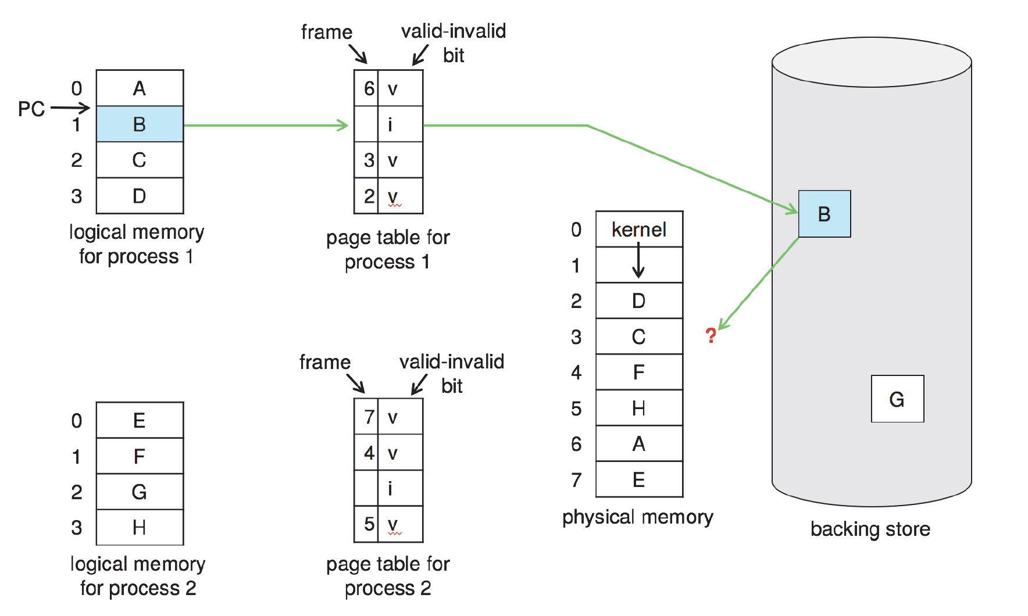
No free frame

Slide 37
Swapping
A process can be swapped temporarily out of memory to a backing store, and then brought back into memory for continued execution
Backing store – fast disk large enough to accommodate copies of all memory images for all users; must provide direct access to these memory images

Slide 38
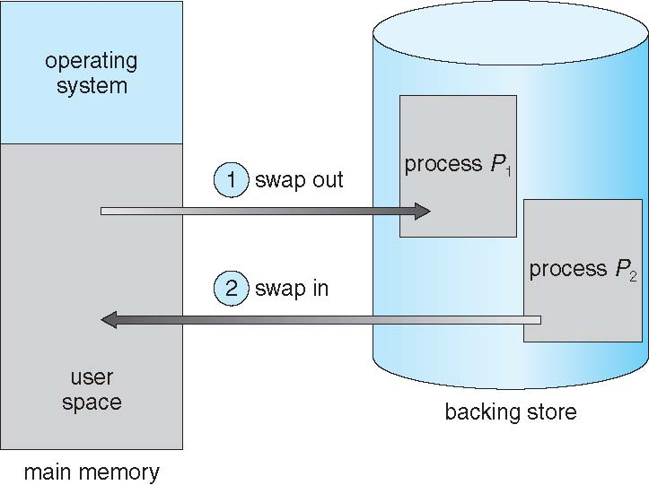
Schematic View of Swapping

Slide 39
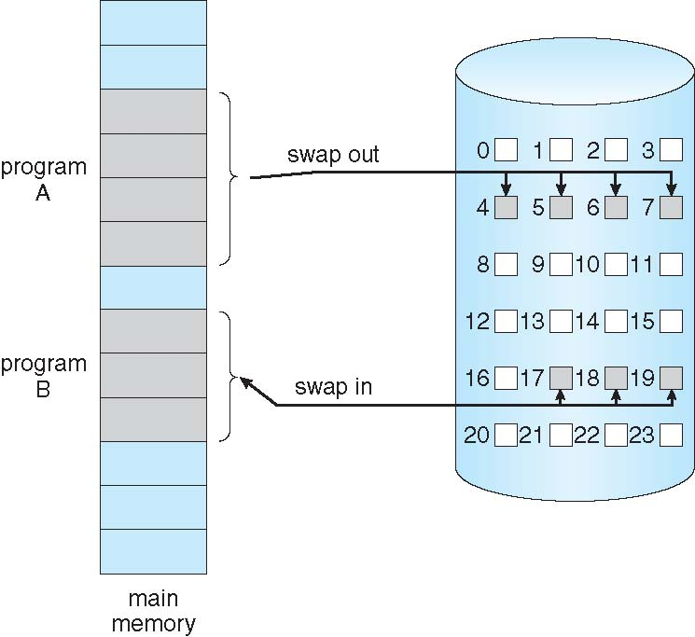
Swapping with paging

Slide 40
Basic Page Replacement
Find the location of the desired page on disk
Find a free frame:
If there is a free frame, use it
If there is no free frame, use a page replacement algorithm to select a victim frame
Write victim frame to disk if dirty
Change page table accordingly
Bring the desired page into the (newly) free frame; update the page and frame tables
Continue the process by restarting the instruction that caused the trap

Slide 41
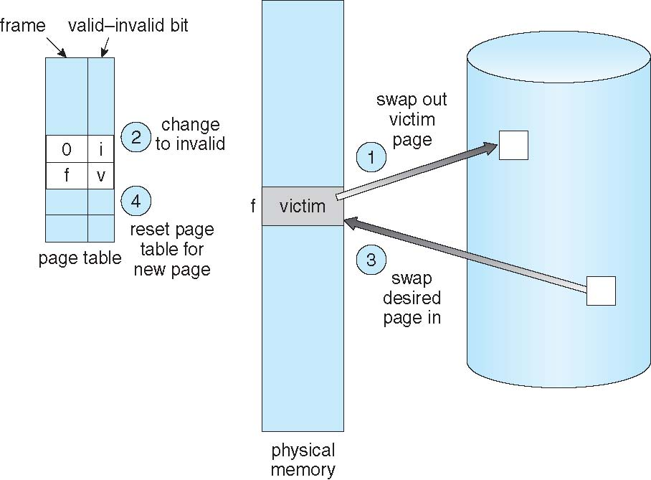
Page Table Update in Page Replacement
f | v
… | …
b₁ | i
b₁
Notes:
确定需求页在磁盘中的位置后，寻找free frame，没有找到，使用算法选择victim，将victim写回磁盘（如果需要），refer bit 改为i，将磁盘内容读入内存，更改页表

Slide 42
Page Table Update in Page Replacement
b₂ | i
… | …
b₁ | i
b₂
b₁

Slide 43
Page Table Update in Page Replacement
b₂ | i
… | …
f | v
b₂
b₁

Slide 44
Performance of Demand Paging (Cont.)
Page Fault Rate 0 ≤ p ≤ 1
if p = 0 no page faults
if p = 1, every reference is a fault
Effective Access Time (EAT)
EAT = (1 – p) x memory access
+ p x page fault time
Swapping： disk IO
Notes:
如果要提高效率，可以从两个角度入手：降低p，降低page fault time

Slide 45
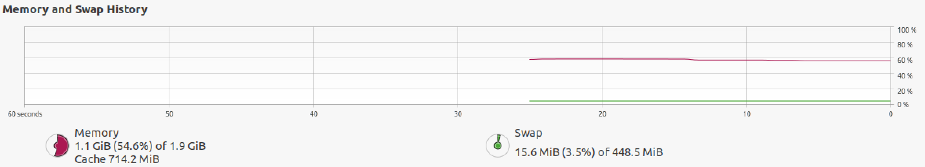
Demand Paging Optimizations (1)
Swap space I/O faster than file system I/O even if on the same device
Swap allocated in larger chunks, less management needed than file system
Demand page in from program binary on disk, but discard rather than paging out when freeing frame
Read-only，not modified (not dirty); otherwise, dirty
Notes:
Linux swap space

Slide 46
Demand Paging Optimizations (2)
Page buffering
A free frame pool
keep list of modified pages, when backing store otherwise idle, write pages there
If referenced again before reused, no need to load contents again from disk
Notes:
如果考虑到swap，即内存空间不足，这一部分buffer的内存空间是否有必要？如果都拿出来分配掉呢？
可以只考虑demand paging，但没有swapping的场景。一个进程退出时物理内存被回收，但是可能存放于一个free frame buffer中，但是内容并没有被情况。在内存足够的情况下，要维护尽可能多的page buffer

Slide 47
Minor vs Major Page Fault
Major page fault (from disk)
Swap area
Disk file system
Minor page fault (from memory)
Page buffering
Give an example: firefox
Notes:
/usr/bin/time -v firefox
ps -eo min_flt,maj_flt,cmd
ps -o min_flt,maj_flt [pid]
top
vmstat 2 1

Slide 48
Firefox page fault

Slide 49
Demand Paging Optimizations (3)
How to choose a victim page to gain a low page fault rate?

Slide 50
Summary
contiguous
segmentation
paging
demand paging
swapping

Slide 51
Memory Access Flowchart
start
CPU check
TLB
restart
Update
Page table
Y
PTE in TLB
Page transferred
To memory
N
Page
replacement
Access page
table
CPU reads page
from disk
N
Page in
Memory?
Memory full?
N
Y
Y
CPU generate
Physical address
Update TLB

Slide 52
End of Chapter 9(1)

